Slide 1
Spring Security
Notes:
Authentication: verify that you are really you. Authorization: verify your rights to access/perform something

Slide 2


Security
Titel van de presentatie
2

Slide 3

Security old school
Titel van de presentatie
3

Slide 4
Security old school
Cookie based security:
User logs in on web page:
  enters username + password
Credentials are send to server
Server authenticates and writes a session value in a cookie
As long as the session is marked active, user can access protected features and resources.
Titel van de presentatie
4

Slide 5


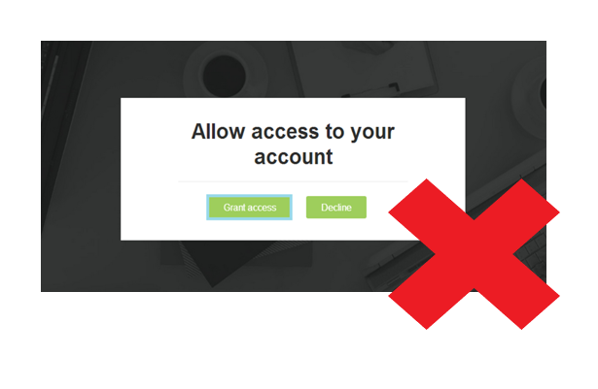
Drawbacks
Titel van de presentatie
5

Slide 6
Drawbacks
Usually bundled with a domain.
  If your application interacts with multiple domains, additional configuration may be required.
Does not play well with mobile clients.
Does not accommodate well the use case where users of one product or service would like to grant third-party clients access to their information on the platform.
Titel van de presentatie
6

Slide 7

Solution
Titel van de presentatie
7

Slide 8
Oauth 2.0
Enables applications to access resources from all kinds of services
It is widely used on the web
OAuth 2.0 allows arbitrary clients to access user’s (resource owner’s) resources on resource servers via authorization servers in a secure, reliable, and efficient manner
OAuth 2.0 is not backwards compatible with the previous version
Titel van de presentatie
8

Slide 9

Explaining Oauth 2

Slide 10





Authentication

Slide 11
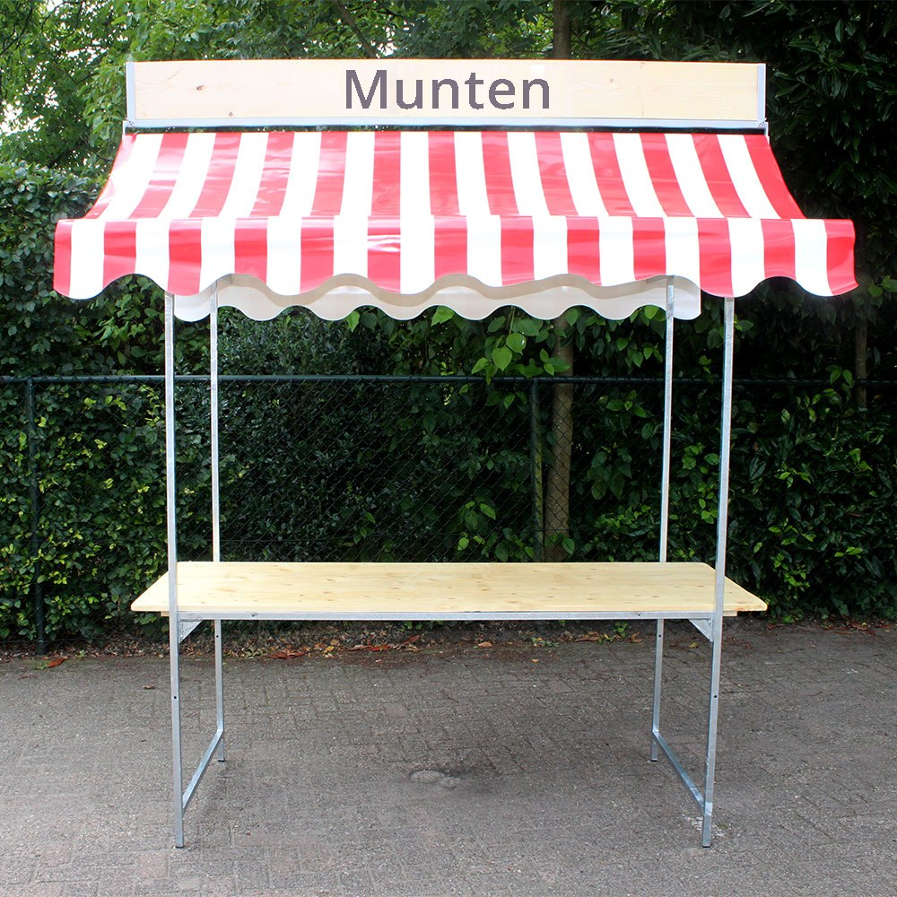



Authorization

Slide 12
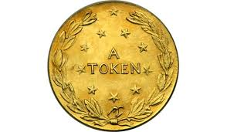

Gain access to (protected) beer resource

Slide 13

Access granted

Slide 14

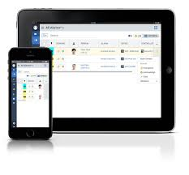



Oauth 2.0 components
Authentication + authorization server
Client
Resource owner
User agent
(protected) resource server
Titel van de presentatie
14

Slide 15
Oauth 2.0 client app
Authentication + authorization server
Registers client apps
Client id
Client secret
Redirect URL
Resource owner
Titel van de presentatie
15

Slide 16
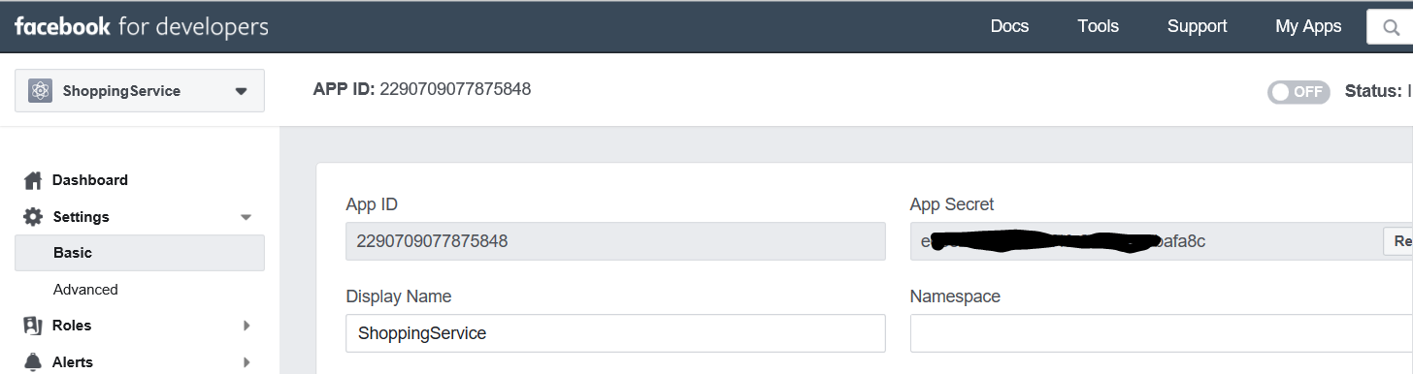
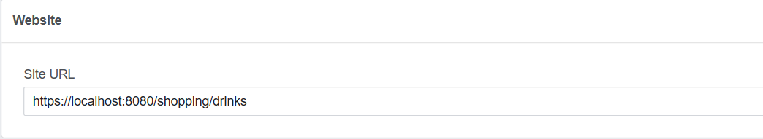
https://developers.facebook.com

Slide 17
Oauth 2.0 authentication
0. unauthenticated client app wants access to protected resource, send request: OAUTH/AUTHORIZE?RESPONSE_TYPE=CODE ..
auth. server sees that user needs to authenticate,
sends redirect for authentication
2. user/resource owner logs in + consents
3. Auth. server redirects to client redirect URI and
sends “authorization code”
Titel van de presentatie
17

Slide 18
Oauth 2.0 authorization grant flow
4. client sends “authorization code” request to obtain access token: OAUTH/TOKEN?GRANT_TYPE=AUTHORIZATION_CODE…
5. auth. server checks “authorization code” and sends
access + optional refresh token
Titel van de presentatie
18

Slide 19
Oauth 2.0 authorization grant flow
6. Client asks access to protected resource and sends token in authorization header type Bearer
Titel van de presentatie
19

Slide 20
Oauth 2.0
4 types of authorization flows:
Authorization Code
  to build a platform where third-party applications and services can access its resources
Resource Owner Password Credentials
  to build a client (a web/mobile application) for your own service
Implicit
  Single-page Javascript Web Applications
Client Credentials
  Non-interactive programs for machine-to-machine communications
Titel van de presentatie
20

Slide 21
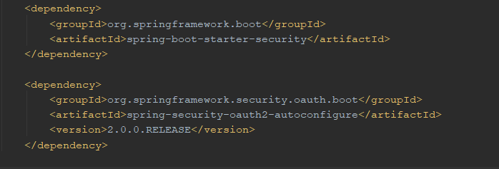
Spring Security
Secure endpoint URIs
Check if user has role(s)
Actuator

Slide 22
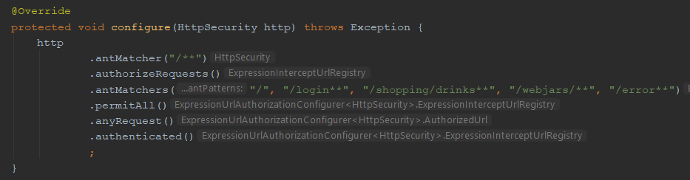
Spring Security : endpoints

Slide 23
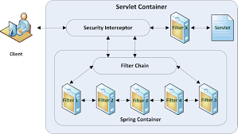
Spring Security : filterchain

Slide 24
Spring Security
https://spring.io/projects/spring-security-kerberos
https://spring.io/projects/spring-security-oauth
http://projects.spring.io/spring-security-saml/

